Slide 1
Netflix_Titles Insights
In this dataset I have not filled the empty cell or completely remove the missing values because it would decrease the number of content that is released on Netlix.Instead of that I have named them as Unknown.
For Example = Unknown Directors
Here is the link to the dataset I have worked on
= https://www.kaggle.com/datasets/shivamb/netflix-shows

Slide 2
In this dataset many directors, Country, Cast names were Missing.
It is cleared that more number of movies are present on Netflix comparing to Tv Shows.
From the of Launch Netflix has released highest number of TV Shows in the month of December and July.
Comparing all other years in 2019 Netflix released more number of content .
In recent years Netflix has increased the number of shows.

Slide 3
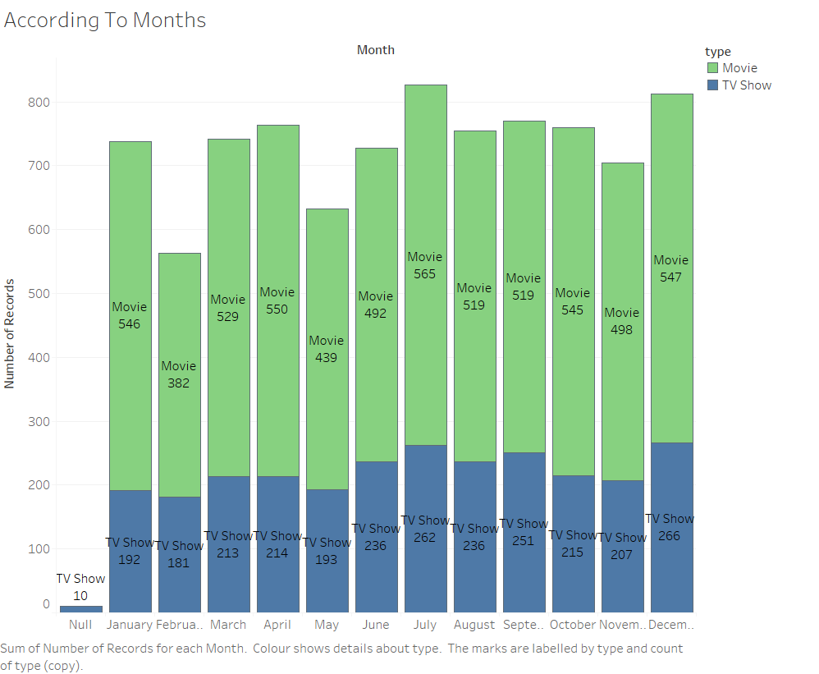
This are the number of movies and tv show that are released in each month from the day of the launch till September 2021

Slide 4
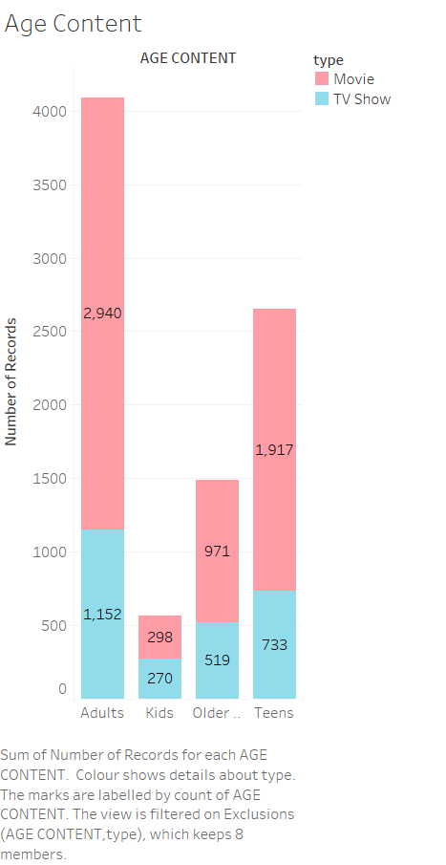
There are more adult Movies and TV Shows on Netflix. It means the shows are appropriate for the age group that are above 18.

Slide 5
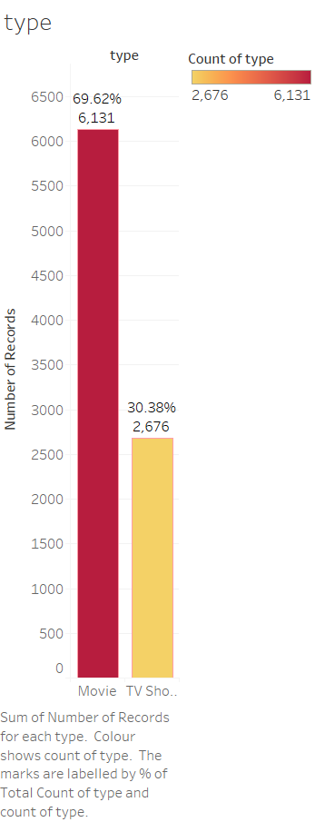
There are More Movies on Netflix as Compared to TV Show.

Slide 6
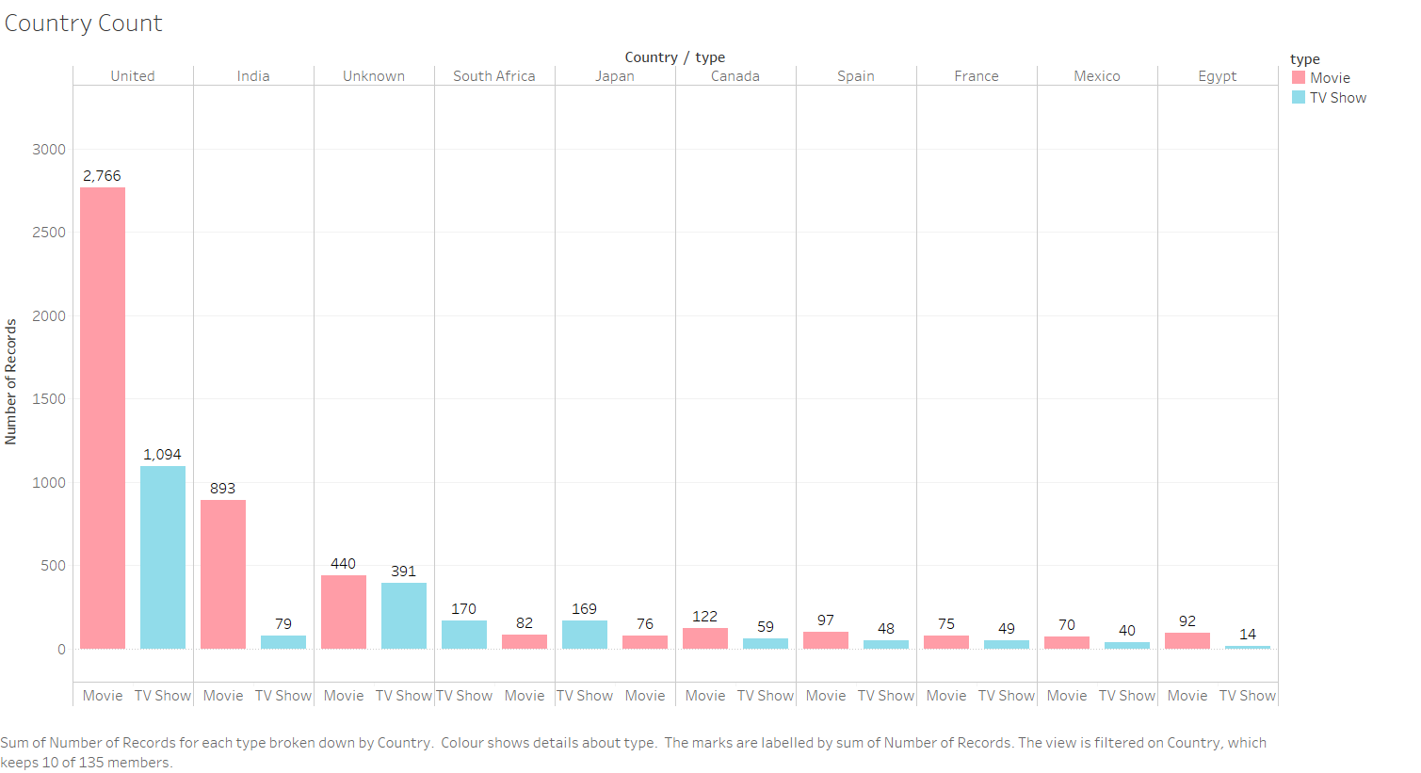
There are more American Movies and TV Shows on Netflix as Compared to Other Countries. Countries Like Japan, Australia, Taiwan, China, Colombia, Singapore have more No. of TV Shows as compared to Movies.

Slide 7
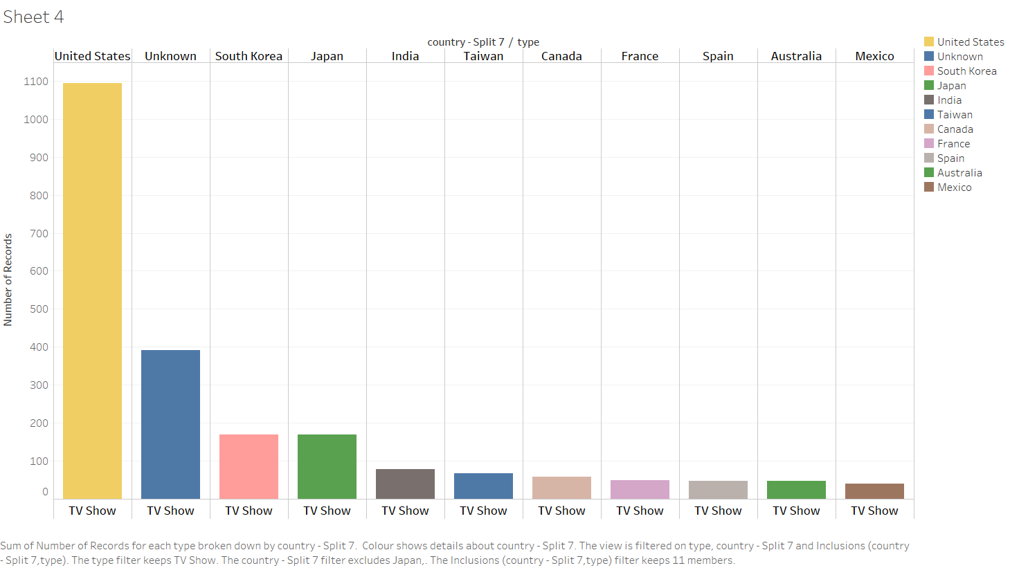
Keeping united states aside, there are more south Korean and Japanese shows on Netflix.

Slide 8
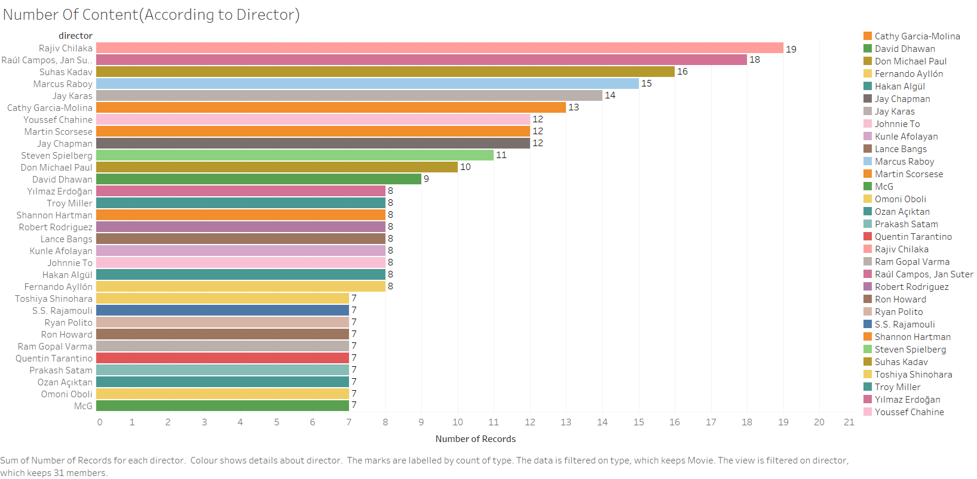
The insight from this graph is that the Rajiv Chilaka has more no. of content on Netflix which belong to Kids Genre.

Slide 9
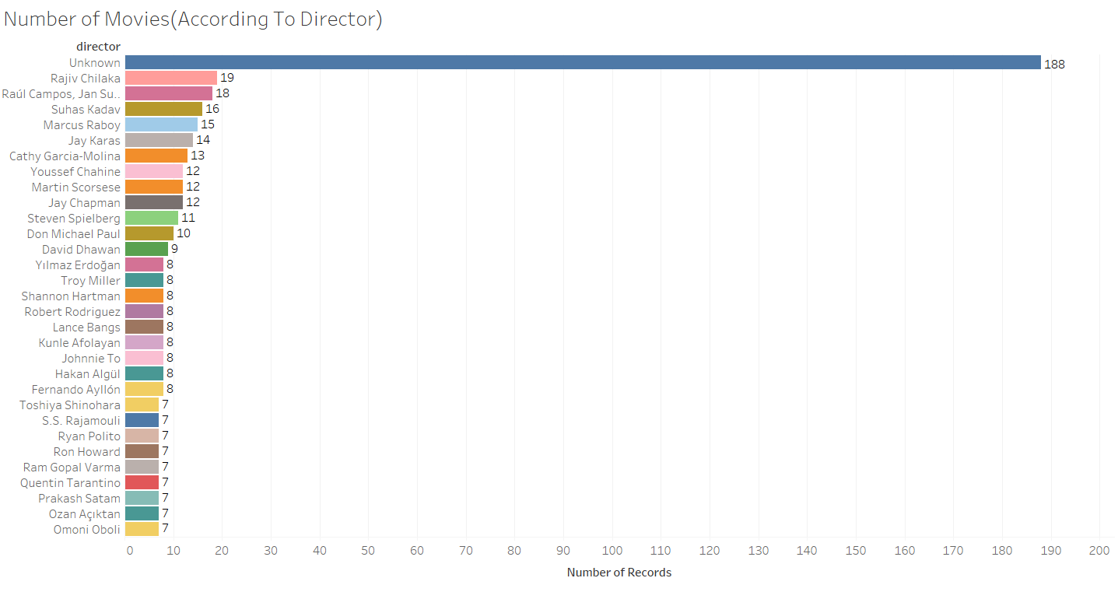
Number of Movies all around the world this directors have on netlfix.

Slide 10
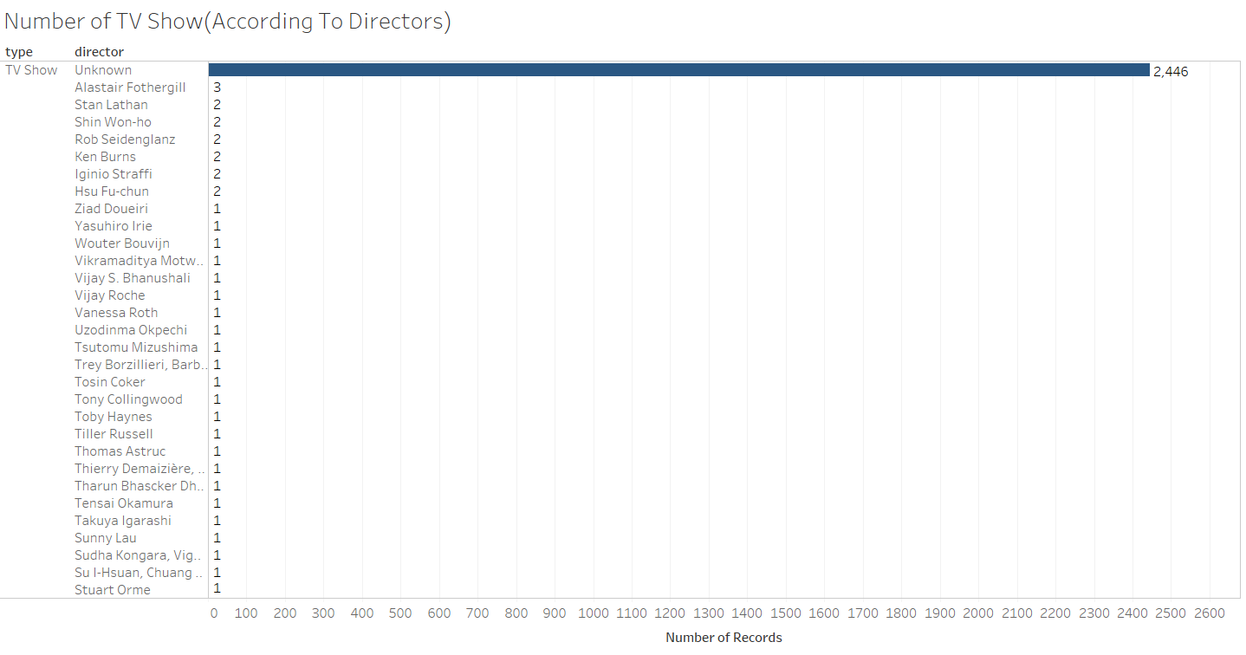
There are less number of tv shows directed by a Particular director .

Slide 11

Lead Actors Collaboration With Other Actors. You can check the Full Collaboration of other actors in Pdf. Link = https://github.com/vaibhavtt24/Netflix/blob/main/Netflix%20Full%20Analysis.pdf

Slide 12
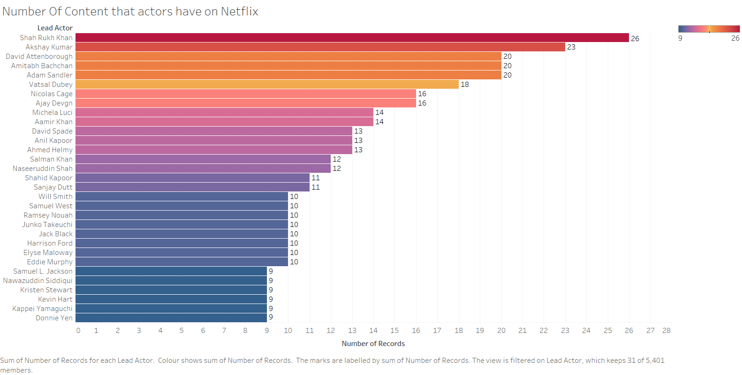
Shah rukh khan has more no. of content as Lead actor on entire Netflix.His content mainly contains movies. David Attenborough Contains both Movies and TV Show on NetFlix.

Slide 13
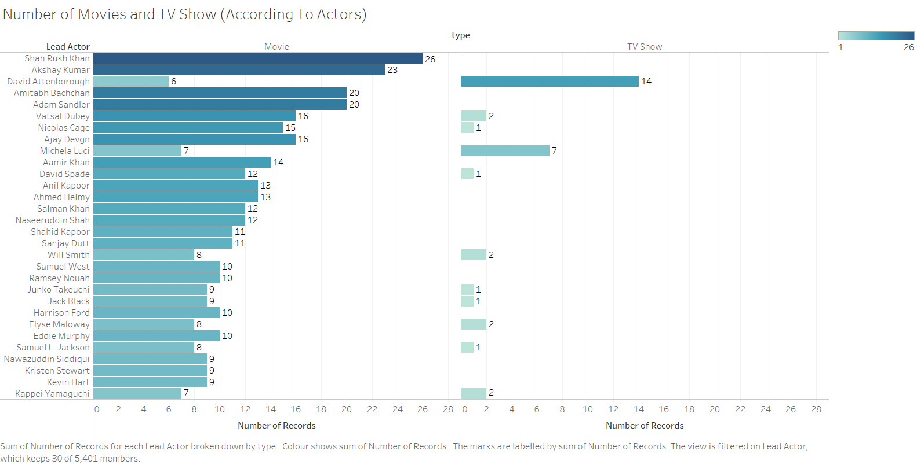
Comparing the content David Attenborough has more no. of TV Shows than any other actor

Slide 14
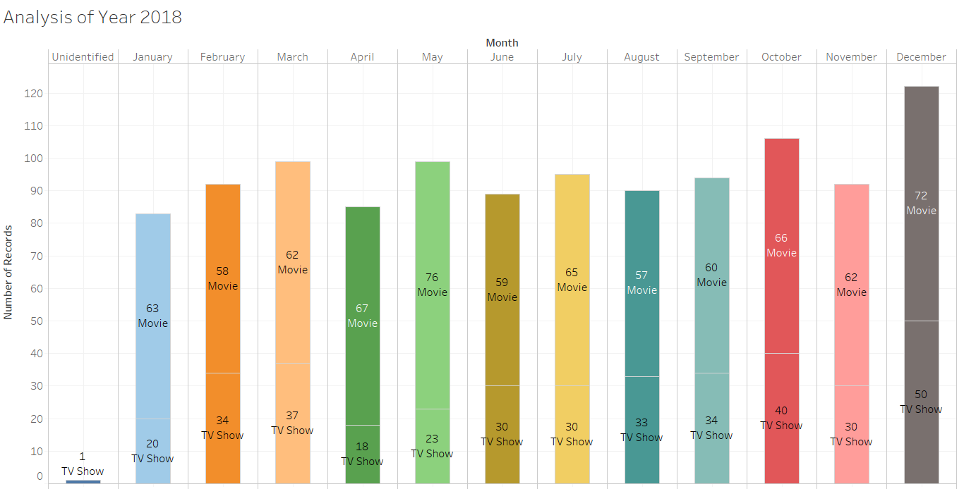
The number of content specifically released in the year 2018.

Slide 15
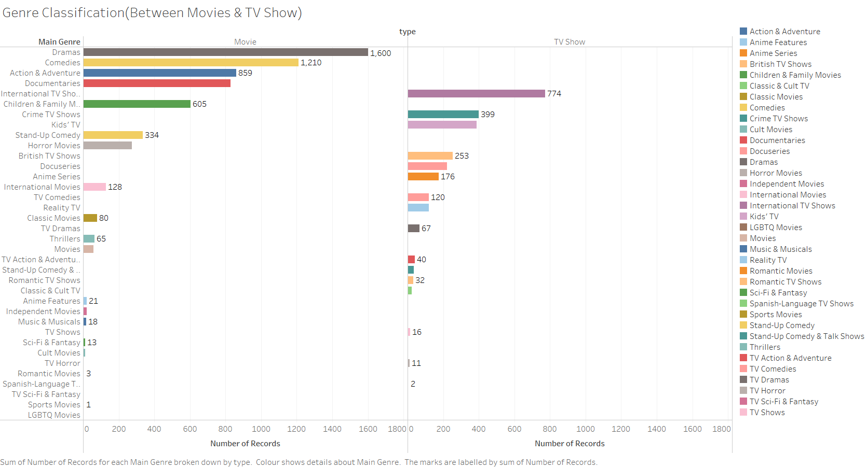
There are more drama genre Movies available on Netflix as compared to comedies.

Slide 16
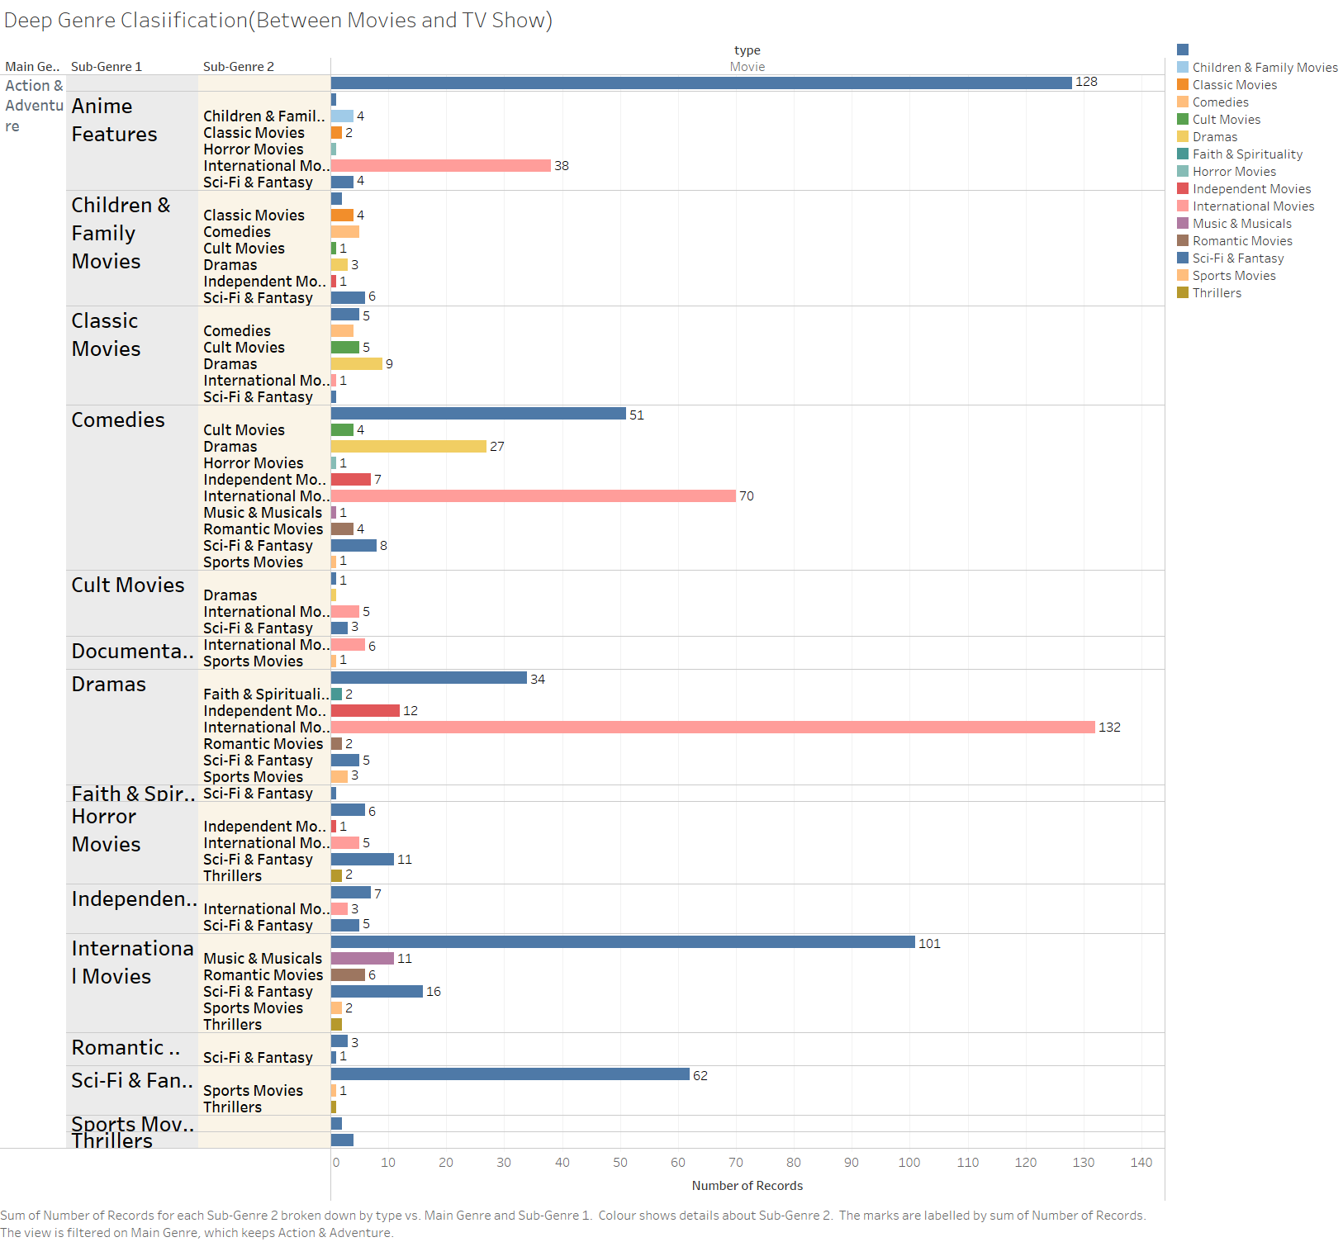
This is more specified Classification of Genre in Movie Section.

Slide 17
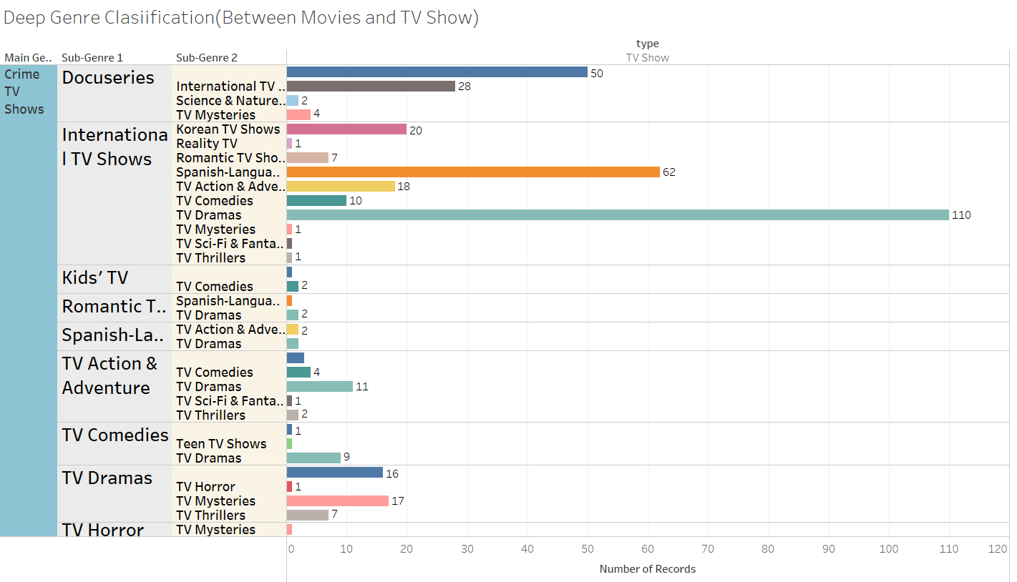
This is more specified Classification of Genre in TV Show Section.

